Slide 1

Temperature
Converter
By . Varshini A

Slide 2
Introduction
The temperature converter project allows users to input a temperature in Celsius, Fahrenheit, or Kelvin and convert it to another unit. The interface includes an input field, dropdown menus for selecting units, a convert button, and a display area for the result. The project aims to provide a simple and efficient way to perform temperature conversions.

Slide 3
HTML STRUCTURE
The HTML file for the temperature converter is structured into several key sections:
  Input Field: Allows users to enter a temperature value.
  Dropdown Menus: Enable users to select the units to convert from and to.
  Convert Button: Triggers the conversion process when clicked.
  Result Display: Shows the converted temperature and unit for easy viewing.

Slide 4
CSS STYLING
The CSS file defines the styling for the converter to ensure a user-friendly and appealing interface:
  Flexbox Layout: Used for aligning and spacing elements consistently.
  Input and Dropdown Styling: Ensures input fields and dropdowns are easy to use and visually appealing.
  Button Styling: Makes the convert button prominent and easy to click with hover effects for interactivity.
  Result Display Styling: Clearly shows the conversion result with appropriate spacing and font size.

Slide 5
JavaScript LOGIC
The JavaScript file handles the conversion logic:
  Input Validation: Ensures the input is a valid number.
  Conversion Function: Converts temperature between Celsius, Fahrenheit, and Kelvin.
  Event Listener: Listens for the convert button click and triggers the conversion.

Slide 6
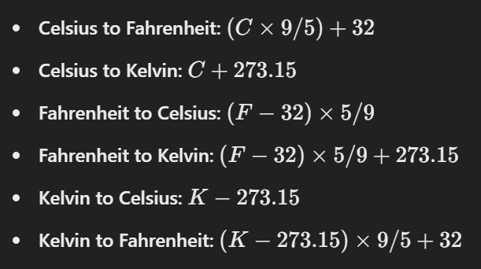
CONVERSION ALGORITHM
The conversion algorithm includes:

Slide 7
CHARACTER SECTION
The character section is designed to showcase the main characters:
  Character Cards: Each character is displayed in a card format with an image, name, and description.
  Flexbox Layout: Ensures characters are well-aligned and spaced evenly.
  Image Styling: Rounded corners and shadows add a polished look to character images.

Slide 8
FAN ART GALLERY
The fan art gallery section showcases fan creations:
  Center Alignment: Images are center-aligned for a balanced layout.
  Flexbox Gallery: Flexbox is used to create a responsive and visually appealing gallery.
  Image Spacing: Adequate spacing between images ensures a clean look.

Slide 9
Conclusioin
In conclusion, the TBATE landing page effectively showcases the story and its characters while providing interactive elements and aesthetic enhancements to engage users. The use of HTML, CSS, and responsive design principles ensures a smooth user experience across devices.

